Slide 1
Survey of NDI Training
FAA Academy
AMA-250
A4A NDT Forum 2018
Ken Working
September 18, 2018

Slide 2
Overview
NDI – Nondestructive Inspection and Evaluation (22518)
Accidents
FAA Guidance/Advisory Circular
Systematic NDI Evaluation Process
Common misconceptions and tribal knowledge
Effective Surveillance

Slide 3
Nondestructive Inspection and Evaluation Course (22518)
Common NDI/NDT/NDE Methods
Certification of Personnel / Organization
NDI Related Accidents
Role of the Aviation Safety Inspector (FAA)
Systematic NDI Evaluation Process

Slide 4
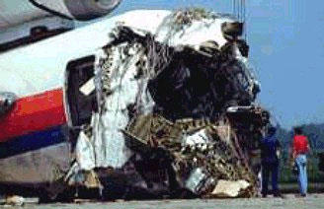
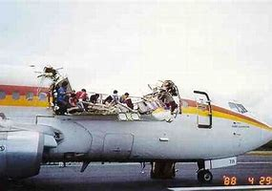
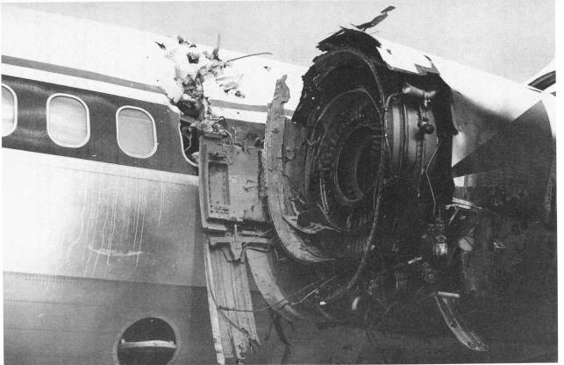
Accidents with NDI Implications
1
United 232
Aloha 243
2
Delta 1288

Slide 5
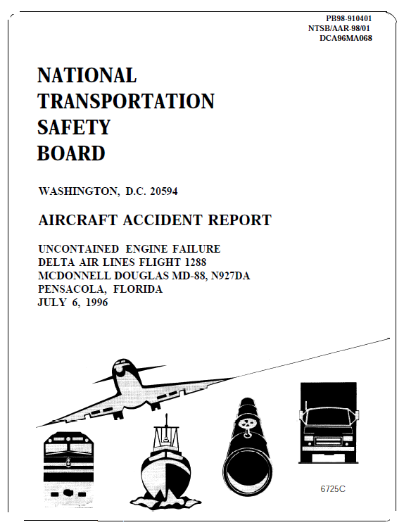
NDI Related Accidents
Delta 1288 - Pensacola, FL
“…the probable cause…was the fracture of the left engine’s front compressor fan hub, which resulted from the failure of Delta Air Lines’ fluorescent penetrant inspection process to detect a detectable fatigue crack initiating from an area of altered microstructure that was created during the drilling process…and that went undetected at the time of manufacture.”
NTSB-AAR98/01

Slide 6
ASI Job Functions
Aviation Safety Inspector/SME/Auditor
ASI’s do NOT perform actual NDI.
Certification-Design Assessment
Surveillance- Performance Assessment

Slide 7
FAA Publications
Regulations 14 CFR Part
121.375, 145.163 Training and qualified personnel
121.367 Competent personnel and adequate facilities
FAA Guidance
8900.1 Vol.6, Chap.11, Sec. 27
Inspect a Nondestructive Program/Facility
Advisory Circular
65-31B Training, Qualification and Certification of NDI Personnel
AC 25-29 Development of a Nondestructive Inspection Program/Organization
AC 43.13B Chapter 5

Slide 8
FAA Publications
Online NDI Job Aid?
A tool designed to help the ASI apply the systematic NDI evaluation process when evaluating an NDI facility
Provides a set of questions from which the ASI may utilize in preparing to evaluate an NDI facility
Nondestructive Inspection
Job Aid

Slide 9
Systematic NDI Evaluation Process
SAFETY
SAFETY
ENVIRONMENT
TRAINING
DOCUMENTATION
ORGANIZATION
CALIBRATION
REGULATORY GUIDANCE
REGULATORY GUIDANCE

Slide 10
Systematic NDI Evaluation Process
Documentation
Manuals
Personnel
Procedures
Data
Record keeping
DOCUMENTATION

Slide 11
Systematic NDI Evaluation Process
Organization
Management perspective of NDI
Structure
Resources
ORGANIZATION

Slide 12
Systematic NDI Evaluation Process
Environment
Safety
Housekeeping
Storage
Consumable management
ENVIRONMENT

Slide 13
Systematic NDI Evaluation Process
Calibration
Process by which an item is checked against a standard
CALIBRATION

Slide 14
Systematic NDI Evaluation Process
Training
Methods
Standards
Training Plan
TRAINING

Slide 15
Systematic NDI Evaluation Process
SAFETY
SAFETY
ENVIRONMENT
TRAINING
DOCUMENTATION
ORGANIZATION
CALIBRATION
REGULATORY GUIDANCE
REGULATORY GUIDANCE

Slide 16
Survey of Nondestructive Inspection Training
Common misconceptions and tribal knowledge
A&P can perform FPI if shown in vo-tech school?
CFR Part 147 - Appendix B
This appendix lists items required in general curriculum subjects for an A&P school
Need for System performance checks
Repair Station (Part 145) has Company level II perform inspection on a part 121 Air Carrier
Difference between Relevant/Non-/relevant Indication

Slide 17
Effective Surveillance
Systematic Approach
Scoped for the operation
Policies vs. Procedures
Controls to mitigate unacceptable risk
Process Measurement – ID issues and corrective action
Interfaces

Slide 18
THANKS!

